Slide 1
WHERE
LEADERS
ARE MADE

Slide 2
District 95, Area D4 and D6 Club Officer Training

Slide 3
District 95, Division D Area D2, D3, D4 Club Officer Training

Slide 4
Agenda-Club Officer Training
10:30-10:45 Balázs Kuzsel Intro,
10:45-11:00 Balázs Kuzsel TM news
11:00-11:15 Eszter Farnady Club Officer training intro
11:15-12:30 Mentors Officer training roundtables
12:30:13:00 All Report out
Questions and Answers

Slide 5
Agenda-Club Officer Training
13:00-14:00 LUNCH
14:00-14:45 Eszter Farnady Chartering made easy
14:45-15:30 Zsuzsanna Lukács Time management
15:30-16:00 Break and Networking
16:00-16:45 Dávid Tasnádi DCP
16:45-17:30 Ildikó Szilágyi Konferenciaszervezés
17:30-17:45 Closing and Adjourn

Slide 6
Introduction
Name
Club
Officer role
TM Achievements

Slide 7
District 95, Division D,
Area D2, D3, D4 Club Officer Training Unity & Split

Slide 8
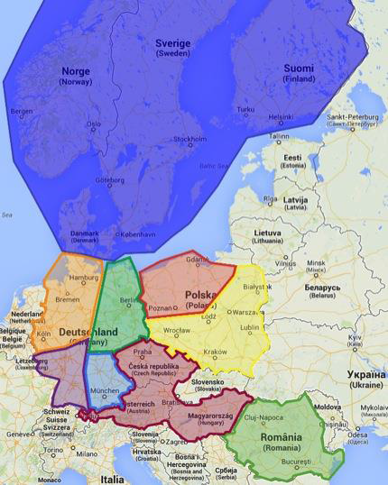
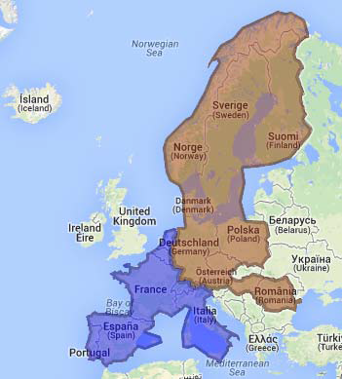
District 95 – before July 1st, 2015
Divisions
District
G
95
E
A
C
B
59
F I
D
H

Slide 9
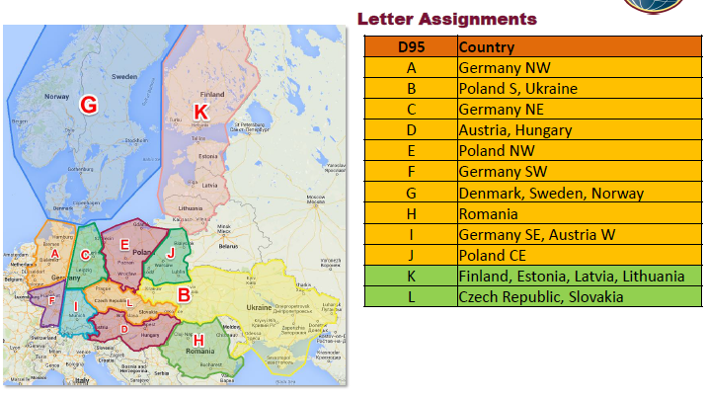
District 95 – after July 1st, 2015
G
95
E
A
C
B
59
F I
D
H

Slide 10
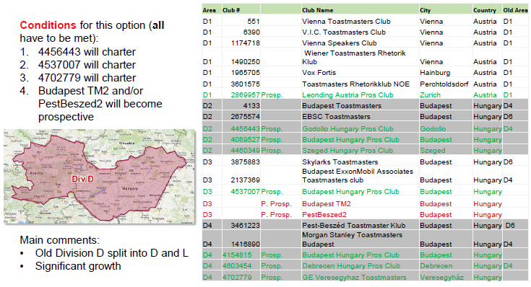
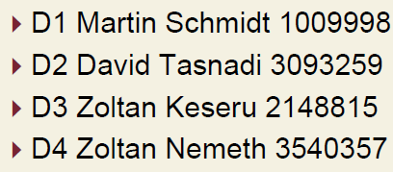
Division D
District
G
95
E
A
C
B
59
F I
D
H

Slide 11
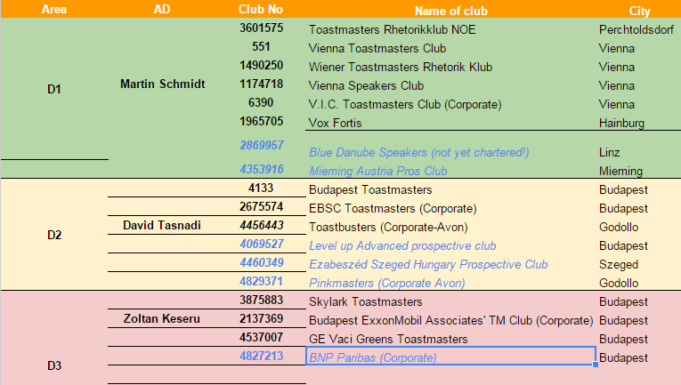
TM Clubs in Division D (as of July 1st 2015) under realignment

Slide 12
Mission, Values
Mission, Values and Envisioned Future
The mission statements, the value statement and envisioned future succinctly express the function of each organizational unit.
Toastmasters International Mission
We empower individuals to become more effective communicators and leaders.
District Mission
We build new clubs and support all clubs in achieving excellence.
Club Mission
We provide a supportive and positive learning experience in which members are empowered to develop communication and leadership skills, resulting in greater self-confidence and personal growth.
Toastmasters International Values:
Integrity
Respect
Service
Excellence
Toastmasters International Envisioned Future
To be the first-choice provider of dynamic, high-value, experiential communication and leadership skills development.

Slide 13
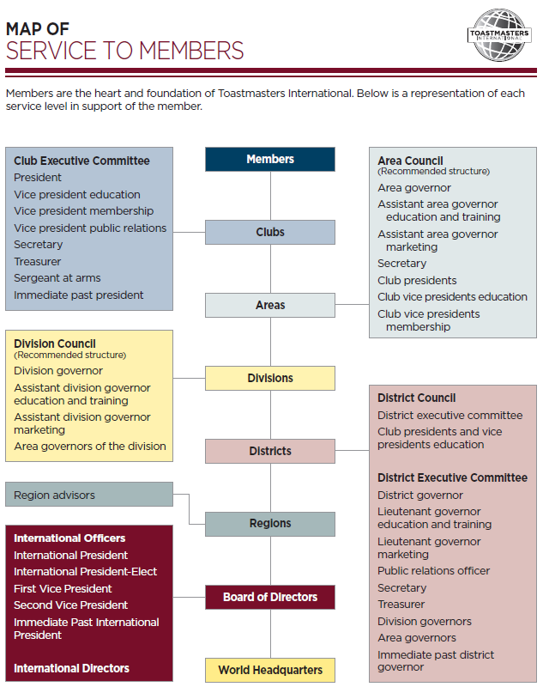
Service to Members
Members – All members
Club Leadership – You All
Area Governors D2, D3, D4 – Dávid Tasnádi, Zoltán Keserű, Zoltán Németh
Division Governor D – Eszter Farnady
District Director 95 – Tuire Vuolasvirta
Program Quality Director – Michal Talaga
Club Growth Director – Bea Bincze
Regional Advisor – Morag Mathieson

Slide 14
Area Council
AREA GOVERNOR
is responsible for leading the area by serving the needs of clubs.
Conduct club visit, discusses each club’s plans and goals in the Distinguished Club Program.
AREA COUNCIL
The area council manages area activities and supports each club in the area in fulfilling the club mission.
Members:
area governor
(assistant area governor education and training)
(assistant area governor marketing)
(area secretary)
club presidents
club vice presidents education
club vice presidents membership

Slide 15
DCP – 2015-07-09

Slide 16
DCP – 2015-07-09

Slide 17
Tall Tale Picnic – Nagyotmondó Piknik
July 18th
Ménesi út 12.
FUN FUN FUN
HUMOR, MÓKA, KACAGÁS

Slide 18
District Conference

Slide 19
Club Officer Training

Slide 20
D95 Contact
Webpage http://www.toastmastersd95.org
Closed group https://www.facebook.com/groups/283365441826421
Public page https://www.facebook.com/ToastmastersDistrict95
Continental Europe
Open page https://www.facebook.com/ToastmastersContinentalEurope
D95 http://twitter.Toastmasters95 @Toastmasters95 #TM95

Slide 21
Useful materials
How to Build a Toastmasters Club (Item 121) www.toastmasters.org/build
Club Leadership Handbook (Item 1310) www.toastmasters.org/1310
Distinguished Club Program and Club Success Plan (Item 1111) www.toastmasters.org/1111_DCP
Speech Contest Rulebook (Item 1171) www.toastmasters.org/1171

